Slide 1

Customer Segmentation
An Experiment with unsupervised Learning models - clustering

Slide 2
About the project
The utility of segmenting customers.
Available Data.
Unsupervised Machine Learning Models.

Slide 3
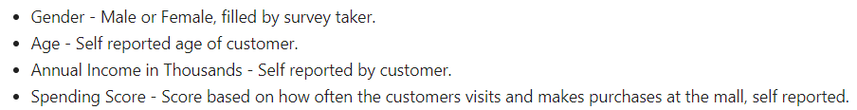
About the Data
Marketing Survey Dataset.
Clean Dataset
5000 observations
5 columns

Slide 4

Project Steps
EDA
Model Building (4)
Model Evaluation

Slide 5
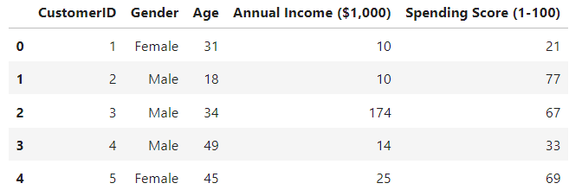
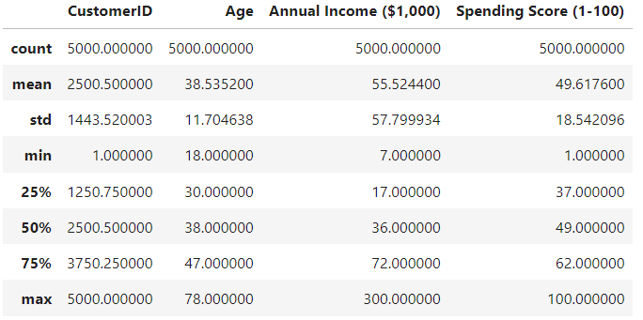
Step 1 EDA
Basic data Layout
Understanding the Columns
Basic Shape of the Data

Slide 6
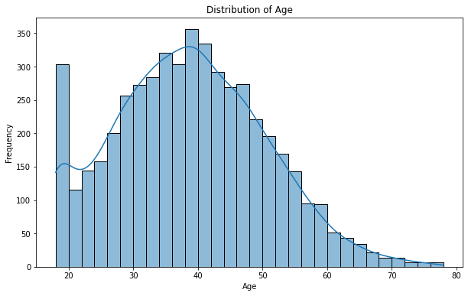
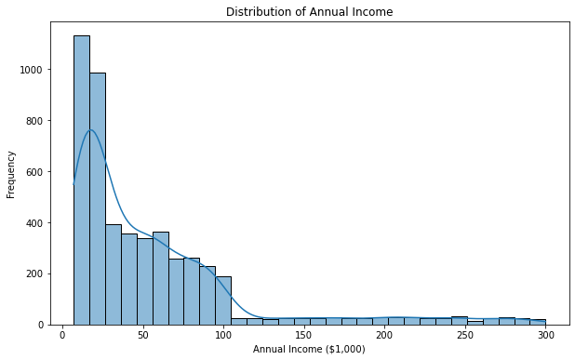
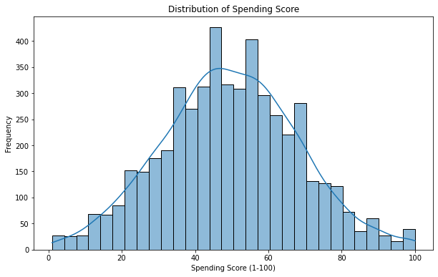
EDA

Slide 7
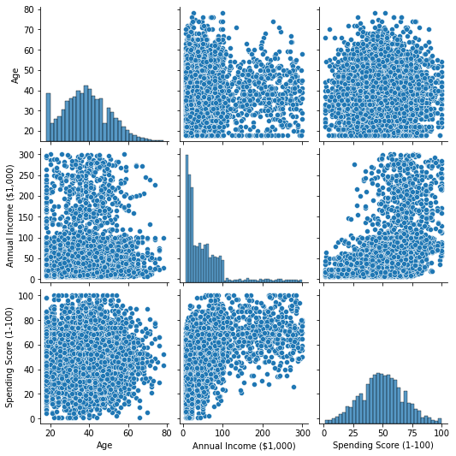
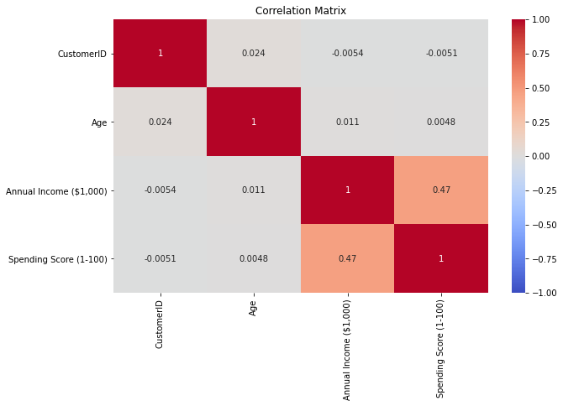
EDA

Slide 8
Model Building
KMeans
DBSCAN
Agglomerative / Gaussian

Slide 9
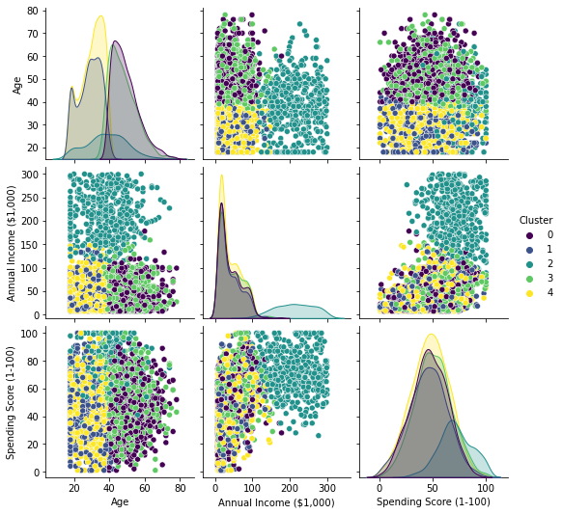
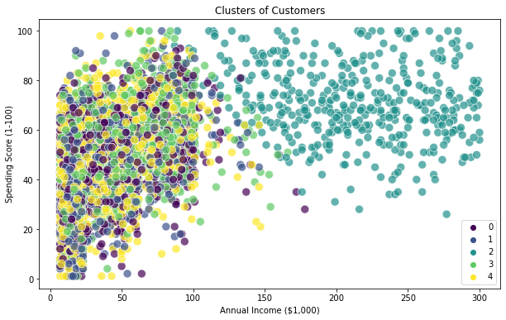
KMeans

Slide 10
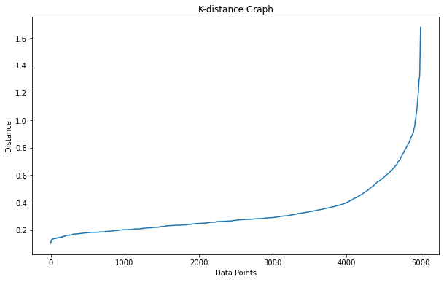
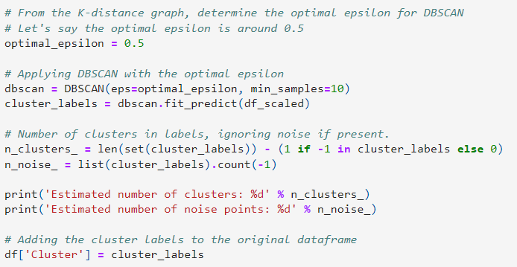

DBSCAN

Slide 11
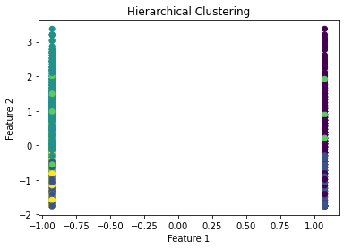
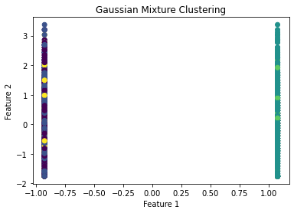
Hierarchical - Agglomerative Modeling / Gaussian Mixture

Slide 12
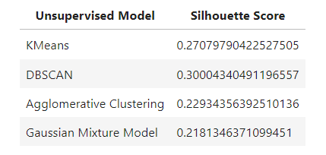
Step 3 Evaluation

Slide 13
Conclusions and suggestions
Complex problem based on human behaviour.
DBSCAN performed the best out of all the models.
Hierarchical models do not seem to be that efficient for this problem.
Testing other models.
Using Deep Learning to tackle this problem.

Slide 14

Thank You

